Slide 1
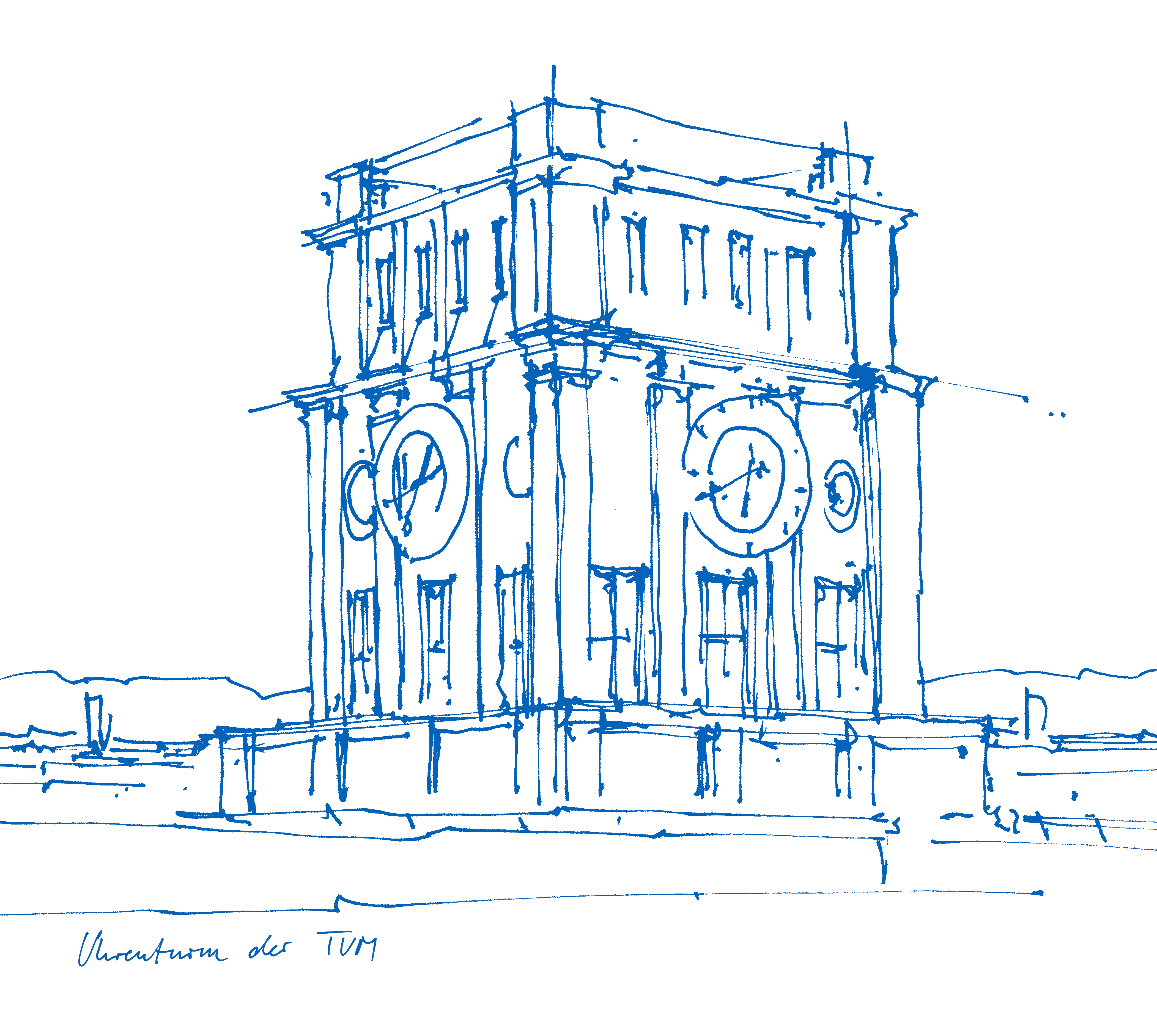
SmartCard Lab: Final Presentation
Group 2
Martin Achtner
Ridon Arifi
Ines Ben Hmida
Maximilian Galanis
Simon Ulshöfer
Notes:
1

Slide 2
Outline
Team B – Countermeasures
Implemented Countermeasures
Impact of Countermeasures
Random Number Generation
Team A – DPA
Improvements
countermeasures
benchmarks
Project Plan
SmartCard Lab | 03.07.2018 | Final Presentation Group 2
2
Notes:
2

Slide 3
Team B – Countermeasures
Implemented Countermeasures
Impact of Countermeasures
Random Number Generation
SmartCard Lab | 03.07.2018 | Final Presentation Group 2
3
Notes:
3

Slide 4
Implemented Countermeasures
Masking
Hiding
Shuffling
NOPs
SmartCard Lab | 03.07.2018 | Final Presentation Group 2
4
Notes:
4

Slide 5
Masking
Precomputation:
Generate „input and output masks“ m, m’ → (m_i, mp_i)
Precompute masked inv. S-Box S’(x): S‘(x ⊕ m‘) = S(x) ⊕ m
Generate „transformed masks“ m1‘, m2‘, m3‘, m4‘ for inv. MixColumns
Precompute „input masks“ using inv. MC : (m1, m2, m3, m4) = inv. MC(m1’, m2’, m3’, m4’)
SmartCard Lab | 03.07.2018 | Final Presentation Group 2
5
Notes:
5

Slide 6
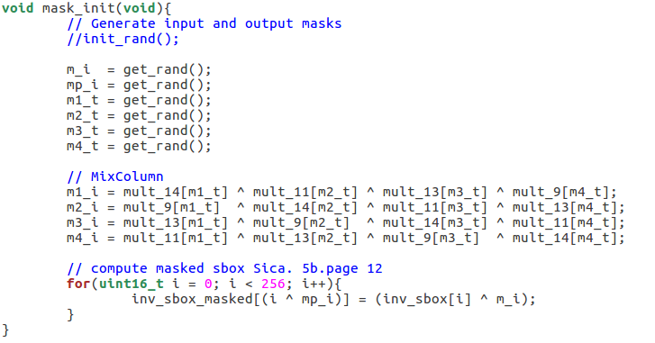
Masking
m_i → m mp_i → m’ m1_t → m1’ ...
SmartCard Lab | 03.07.2018 | Final Presentation Group 2
6
Notes:
6

Slide 7
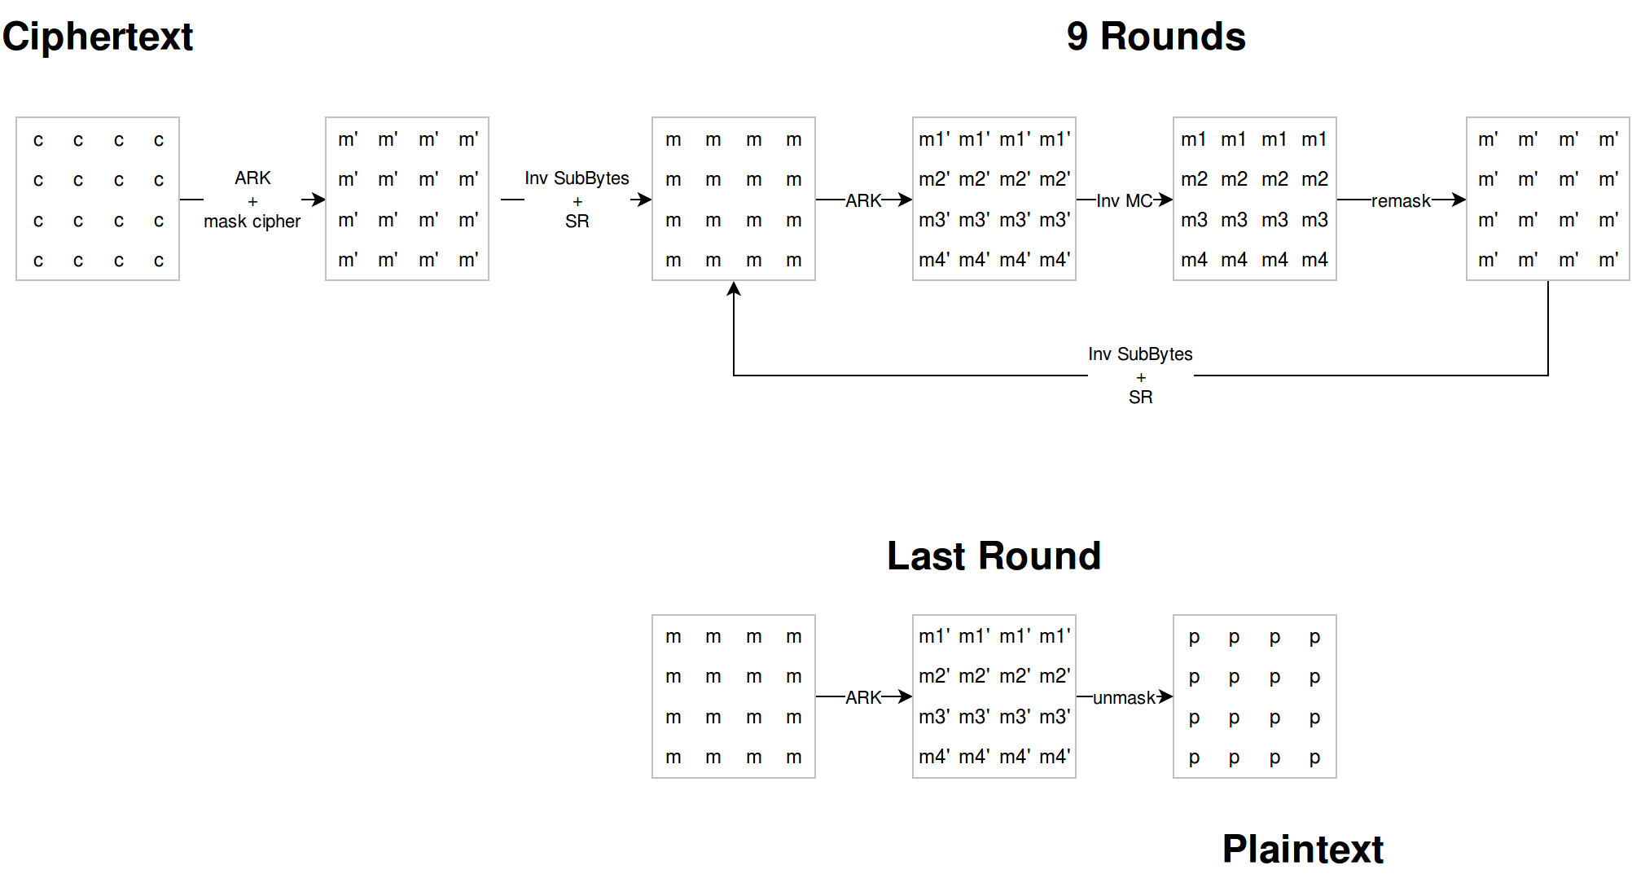
Masking
SmartCard Lab | 03.07.2018 | Final Presentation Group 2
7
Notes:
7

Slide 8
Masking
SmartCard Lab | 03.07.2018 | Final Presentation Group 2
8
Notes:
8

Slide 9
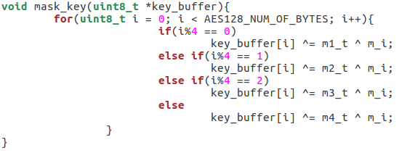
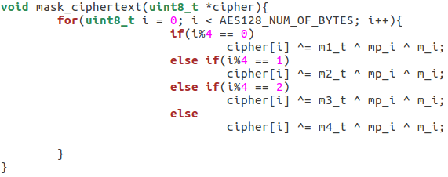
Masking
SmartCard Lab | 03.07.2018 | Final Presentation Group 2
9
Notes:
9

Slide 10
Masking
SmartCard Lab | 03.07.2018 | Final Presentation Group 2
10
Notes:
10

Slide 11
Masking
m_i → m mp_i → m’ m1_t → m1’ ...
SmartCard Lab | 03.07.2018 | Final Presentation Group 2
11
Notes:
11

Slide 12
Masking
SmartCard Lab | 03.07.2018 | Final Presentation Group 2
12
Notes:
12

Slide 13
Masking
(m1, …, m4) = MC(m1’, …, m4’)
SmartCard Lab | 03.07.2018 | Final Presentation Group 2
13
Notes:
13

Slide 14
Masking
SmartCard Lab | 03.07.2018 | Final Presentation Group 2
14
Notes:
14

Slide 15
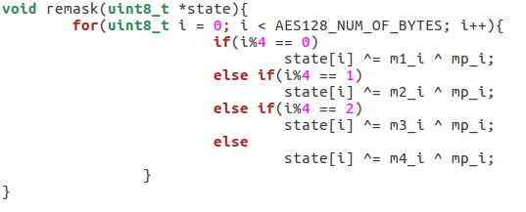
Masking
SmartCard Lab | 03.07.2018 | Final Presentation Group 2
15
Notes:
15

Slide 16
Masking
SmartCard Lab | 03.07.2018 | Final Presentation Group 2
16
Notes:
16

Slide 17
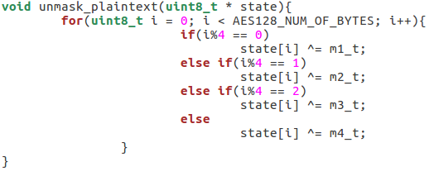
Masking
SmartCard Lab | 03.07.2018 | Final Presentation Group 2
17
Notes:
17

Slide 18
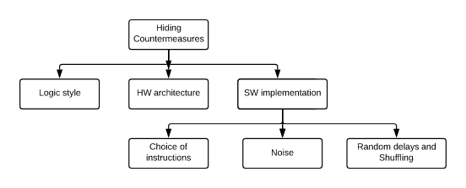
Implemented Countermeasures
Hiding power consumption
Principle: Altering the power consumption of the Smartcard

Slide 19
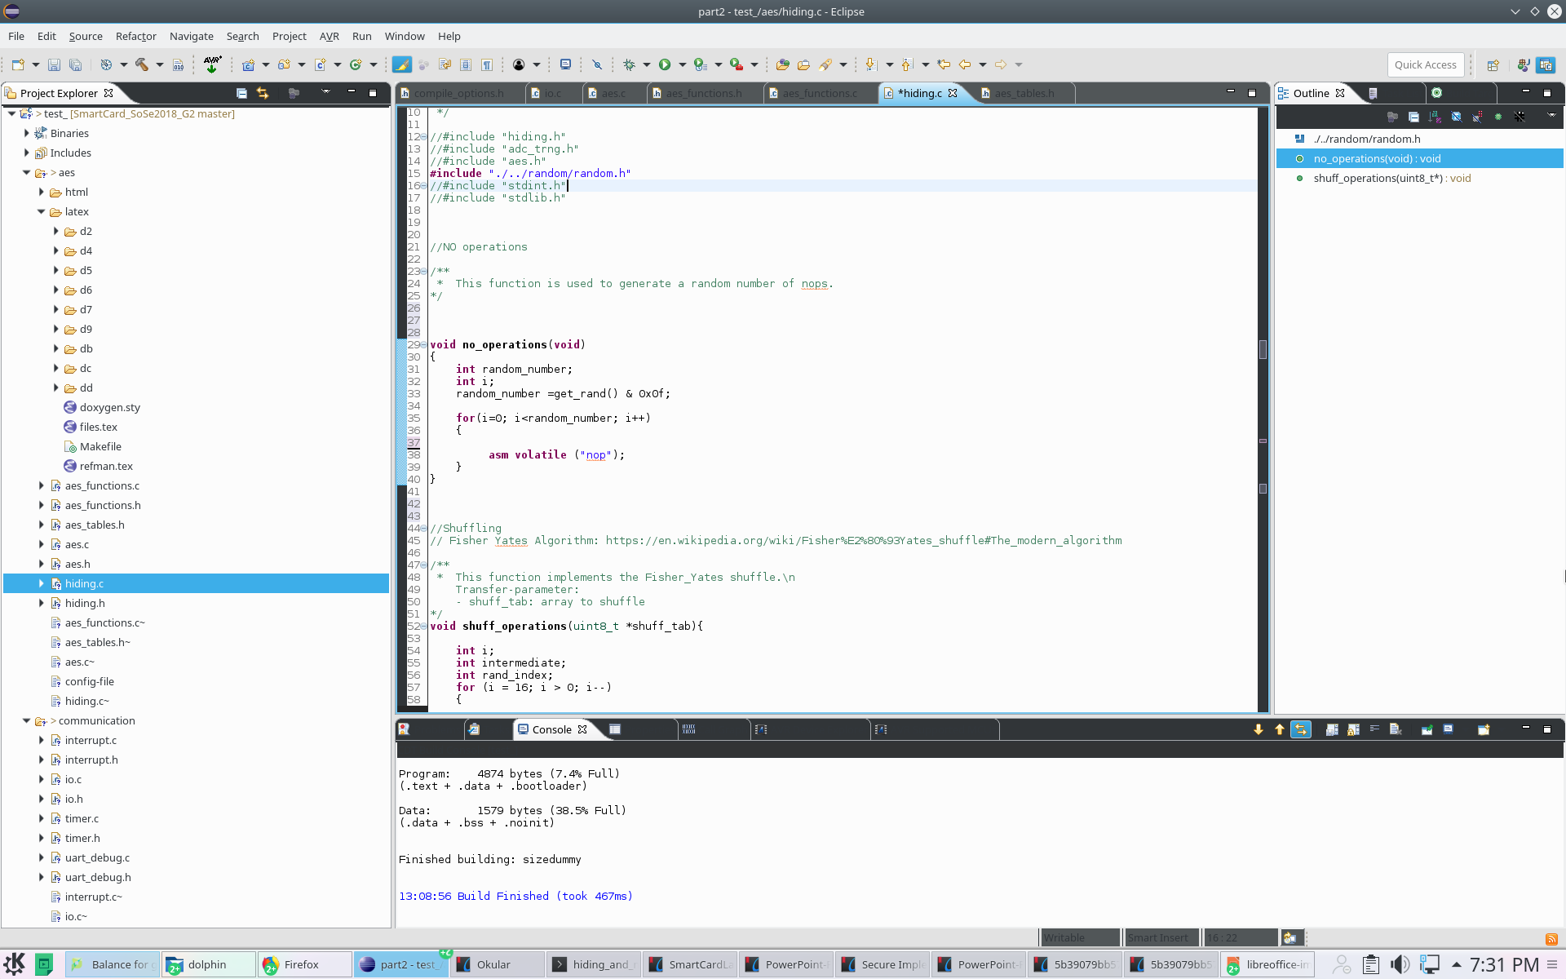
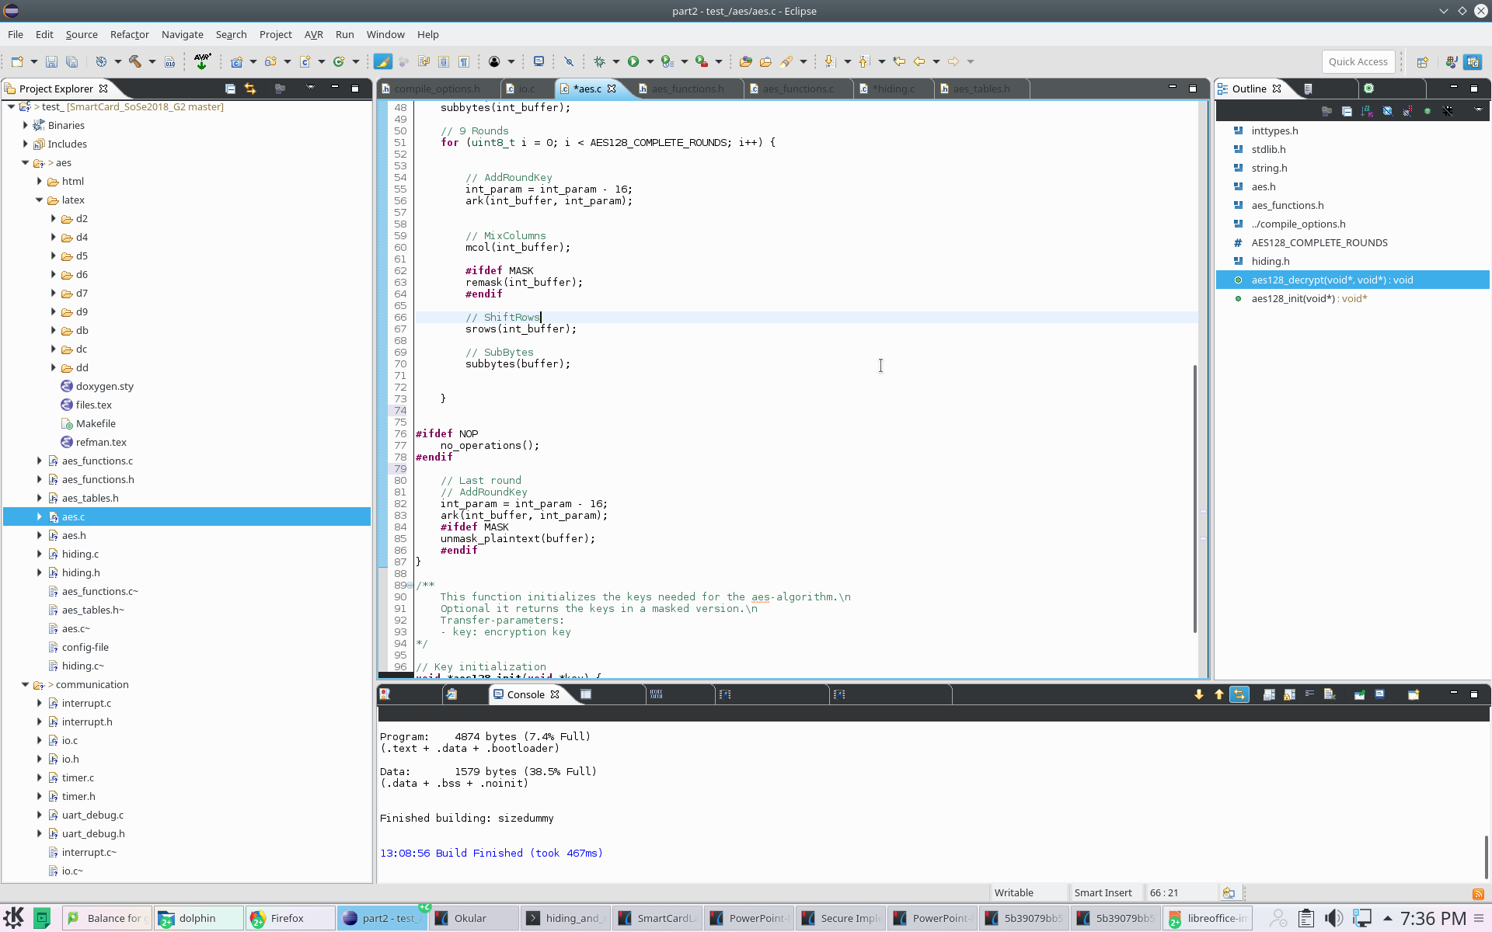
Implemented Countermeasures
NOPs
Principle: Inserting a random number of No operations => Random delays
Implementation: assembly no operations instruction implemented before last round of DES

Slide 20
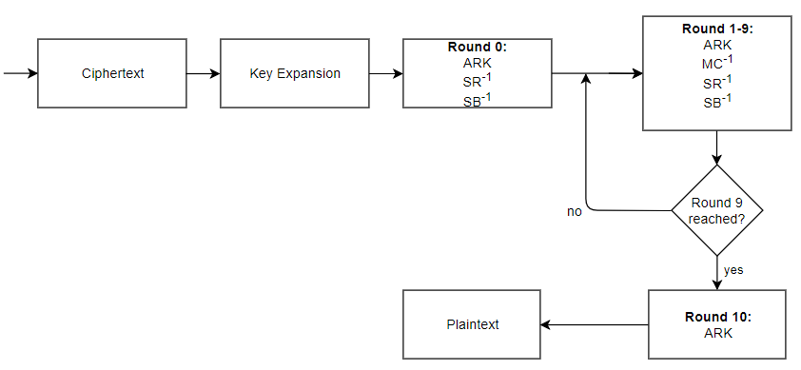
Implemented Countermeasures
NOPs
NOPs

Slide 21
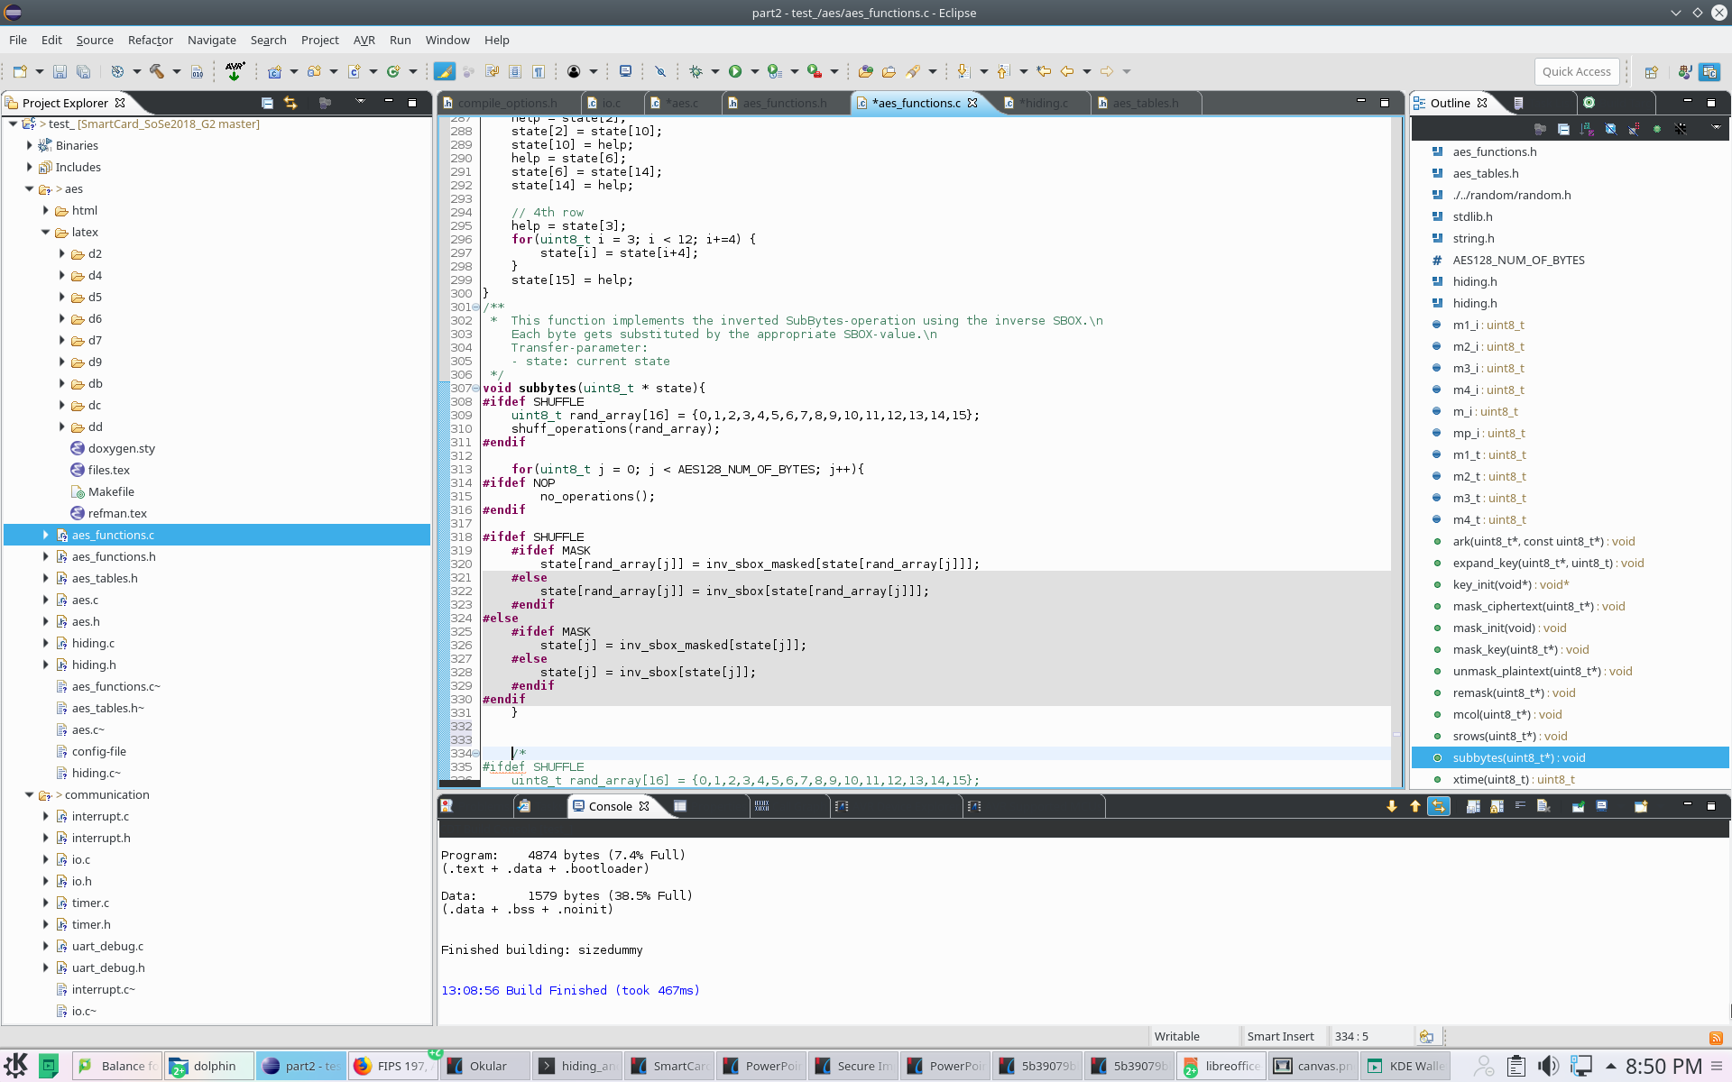
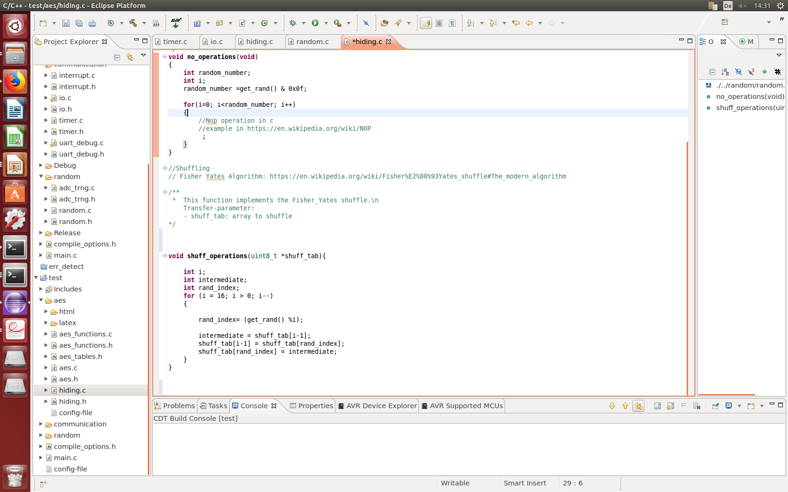
Implemented Countermeasures
Shuffling
Principle: Randomly change the sequence of operations performed in arbitrary order.
Implementation: Fisher-Yates Shuffle algorithm within subbytes table lookups.

Slide 22
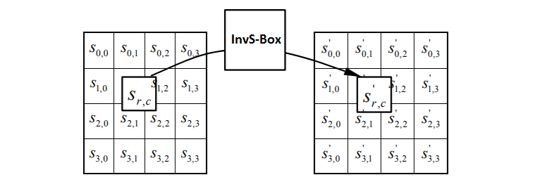
Implemented Countermeasures
Shuffling implemented in the subbytes function
Ordered Lookups from 0 to 16
Randomly Mixed Order Lookups
=> new level of randomization for every subbytes round

Slide 23
Implemented Countermeasures
About the effectiveness of Hiding Countermeasures

Slide 24
Impact of countermeasures

Slide 25
Random Number Generation
True RNG
Implementation
Statistical Tests
Pseudo RNG
Implementation
Statistical Tests

Slide 26
TRNG – Source
LSB of ADC is influenced by noise
Use multiple LSBs to generate a random byte
Use one or more of those random bytes as seed for PRNG

Slide 27
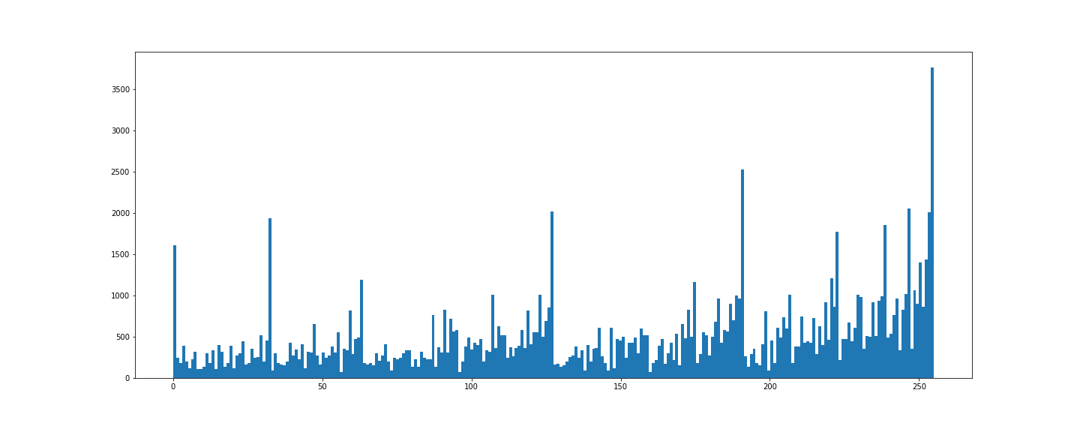
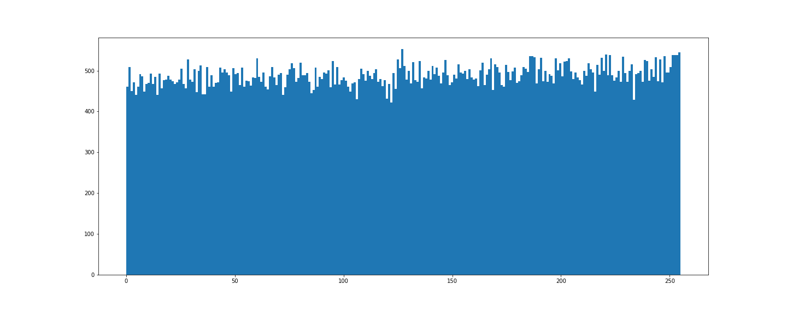
TRNG – Distribution
Using LSB directly
With Von-Neumann Correction

Slide 28
TRNG – Tests
Generated 125.000 Bytes and send them to PC via UART
Applied NIST Test Suite with 1, 10 and 20 streams on the file

Slide 29
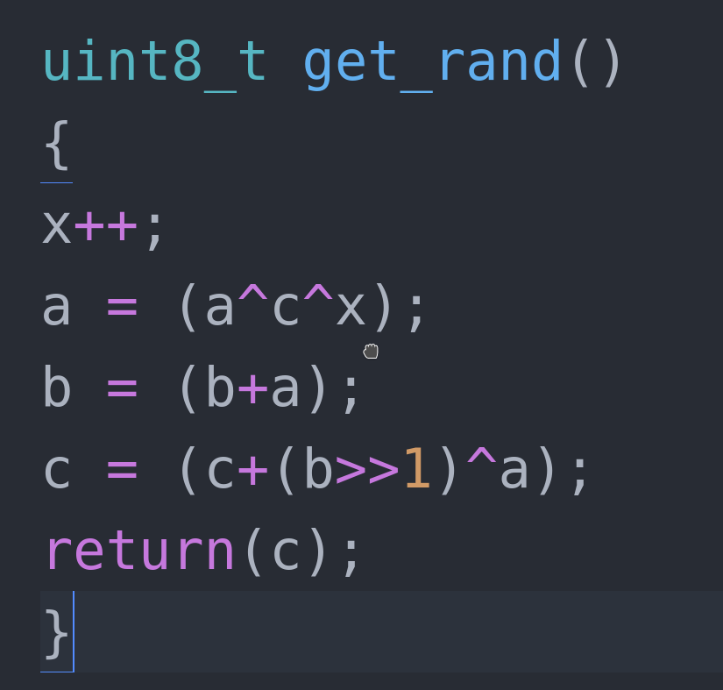
PRNG – Source Code
Three seeds required

Slide 30
PRNG – Statistics
Created 1 million bits
Tested with 1, 10 and 20 streams
All tests passed, results of similiar quality as reference RNG

Slide 31
Speed Improvements
Massive speed improvements by getting rid of for loops
- replace them by using vector operations
time in s

Slide 32
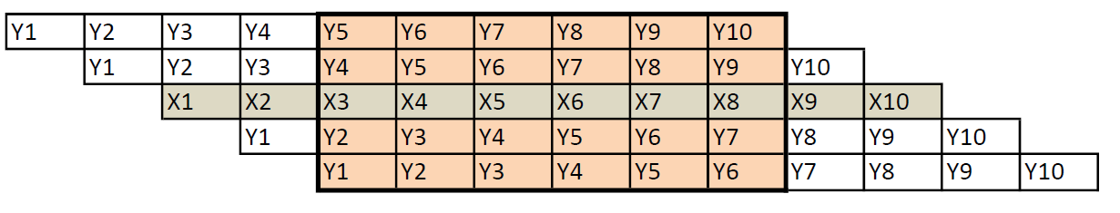
Trace alignment
X-Values = comparison trace (first tarce)
Y-Values = trace
Choose the shift in percent (should be about 100 samples)
Find lowest absolute difference of all shifts
After trace alignment less samples

Slide 33
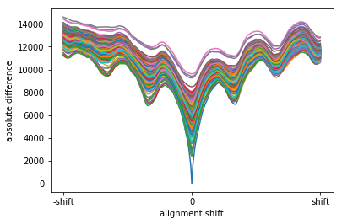
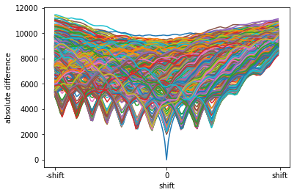
Trace alignment
Trace alignment with no protection
Trace alignment with
nops
Trace alignment at unprotected traces -> worse correlation
Trace alignment at protected traces -> much better correlation

Slide 34
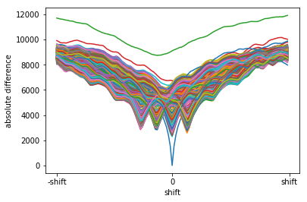
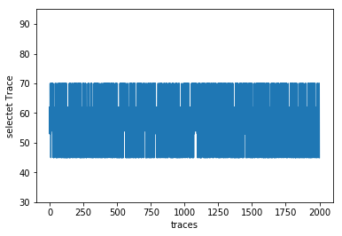
Trace alignment
Best correlation 3 nops
Selected trace 3 nops
Absolute difference for 3 nops
t(total) = 80,306s
Mostly discreet jumps

Slide 35
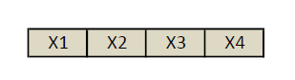
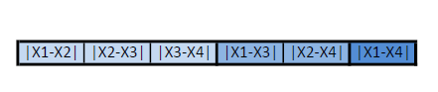
Preprocessing
First: calculation new number of samples
Check results by applying second order DPA on unprotected smart card
-> worth correlation but success

Slide 36
Benchmarks: no decryption
Best correlation (~ 0,5):
- Traces = 400 (given), Samples = 0 – 62500, reduction = 25
→ 1000000 Samples
- T(total) = 0,609s, T(DPA) = 0,449s
Least traces:
- Traces = 157, Samples = 10000 – 55000, reduction = 25
→ 282600 Samples
- T(total) = 0,278s, T(DPA) = 0,232s
Least time:
- Traces = 380, Samples = 32000– 53000, reduction = 500
→ 15960 Samples
- T(total) = 0,077s, T(DPA) = 0,030s

Slide 37
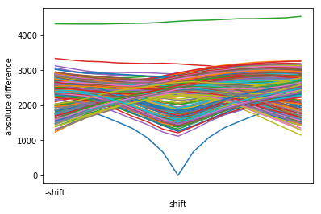
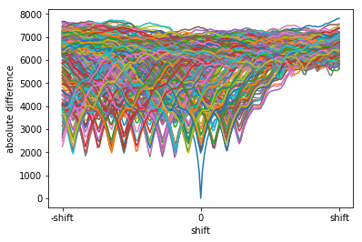
Benchmarks: Hiding
Least time for 3 nops
Least time for 15 nops
t(total) = 1,312s , t(DPA) = 0,176s
Traces = 280, alignment = 0,015%
Samples = 28000 – 55000
t(total) = 11,788s, t(DPA) = 0,269s
Traces =270, alignment = 0,09%
Samples = 0 - 50000
Notes:
37

Slide 38
Benchmarks: Shuffling
We broke the first version of shuffling
- After team B improve there algorithm we are not able to break it
- traces = 10000, Samples = 0 – 125000, reduction = 25

Slide 39
Benchmarks: Masking
Second order DPA works on not decrypted measurement
- Traces = 180, Samples = 12000– 50000, reduction = 100
- T(total) = 1,920s
We can not manage do to attack traces with masking
- Traces = 10000, Samples = 0 – 62500, reduction = 25
- T(total) = ~ 6 min

